Slide 1
University of Gujrat Department of Computer Science
Course Code : CS-252
Computer Organization and Assembly Language
Lecture # 4
Registers, Memory Segmentation
Intel 8086

Slide 2
Organization of the 8086/8088 Microprocessors
8086/8088 had a simplest structure and provided the basic instruction set for the other Intel processors

Slide 3
History
Intel did release some 4-bit microprocessors but the first meaningful processor was Intel 8080 – an 8-bit processor
Intel introduced its 16-bit microprocessor Intel 8086 in 1978
Intel introduced its 8088 microprocessor in 1979 which has a slower clock rate than Intel 8086
IBM chose Intel 8088 for original PC because it was less expensive to build a computer around Intel 8088 than Intel 8086
IBM PC became very popular due to its open architecture and easily available information

Slide 4
Introduction
Had a better performance than earlier processors
Assigns a 20 bit address to its memory locations, so 2²⁰ bytes of memory can be accessed.
Intel 8086 microprocessors has total fourteen 16 bit-registers which include General Data Registers, Address Registers and the Status Register

Slide 5
Registers

Slide 6
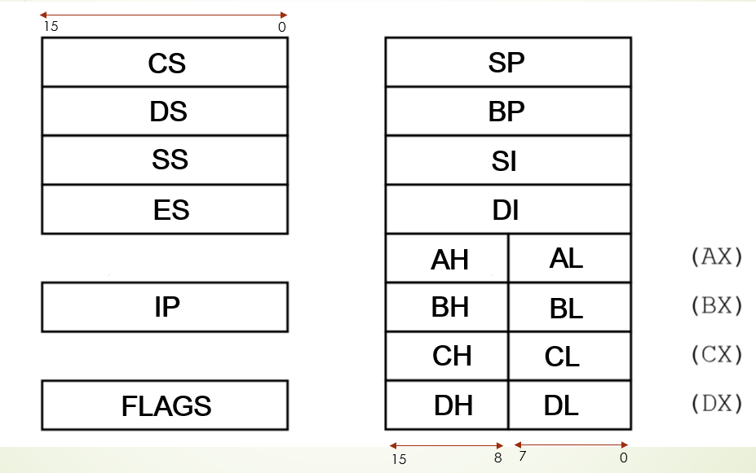
Intel 8086/8088 Registers

Slide 7
Data Registers AX, BX, CX, DX
These four 16-bit registers are available to programmers for general data manipulations. (also called General Purpose Registers)
Instructions are processed faster if data is stored in registers
The high and low bytes of the data registers can be accessed separately
16-bit
AX
AH
AL
8-bit
8-bit

Slide 8
Special Attributes of General Purpose Registers
AX (Accumulator Register)
Fastest for arithmetic operations. Some math instructions only use AX.
BX (Base Register)
This register can hold an address of a procedure or variable. BX can also perform arithmetic and data movement.
CX (Counter Register)
This register acts as a counter for repeating or looping instructions
DX (Data Register)
This register has a special role in multiply and divide operations. In multiplication it holds the high 16 bits of the product. In division it holds the remainder. Its also used in I/O operations.

Slide 9
Segment Registers
Segment registers are used as base locations for program instructions, data, and the stack.

Slide 10
Segment Registers
CS (Code Segment)
Holds the base location of all instructions in a program
DS (Data Segment)
Holds the default base location for variables. It is used by the CPU to calculate the variable location.
SS (Stack Segment)
Contains the base location of the stack.
ES (Extra Segment)
This is an additional base location for memory variables.

Slide 11
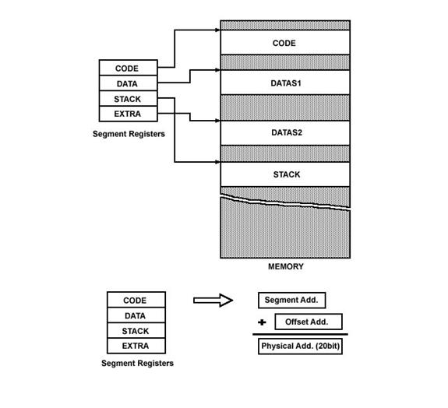
Segment Registers

Slide 12
Index Registers
Index registers contain the offsets of data and instructions.

Slide 13
Index Registers
SP (Stack Pointer)
Contains the offset from the top of the stack. The complete top of stack address is calculated using the SP and SS registers.
BP (Base Pointer)
Used to access data on stack. However, unlike SP, we can also use BP to access data in the other segments.
SI (Source Index)
Used to point to data in memory. Named because this is the index register commonly used as the source in string operations
DI (Destination Index)
Commonly used as the destination in string operations

Slide 14
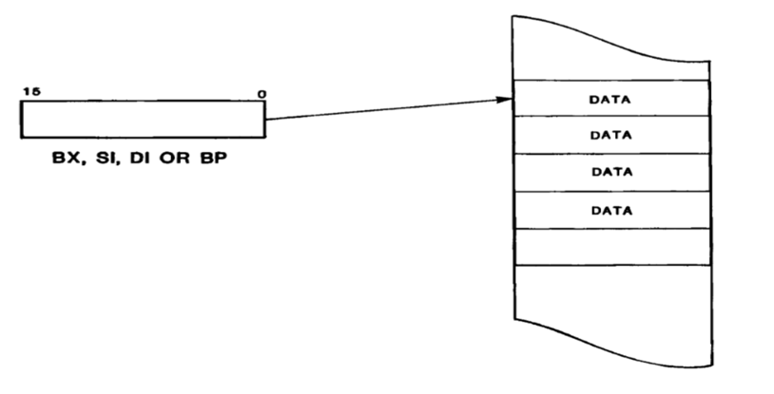
Data Pointers

Slide 15
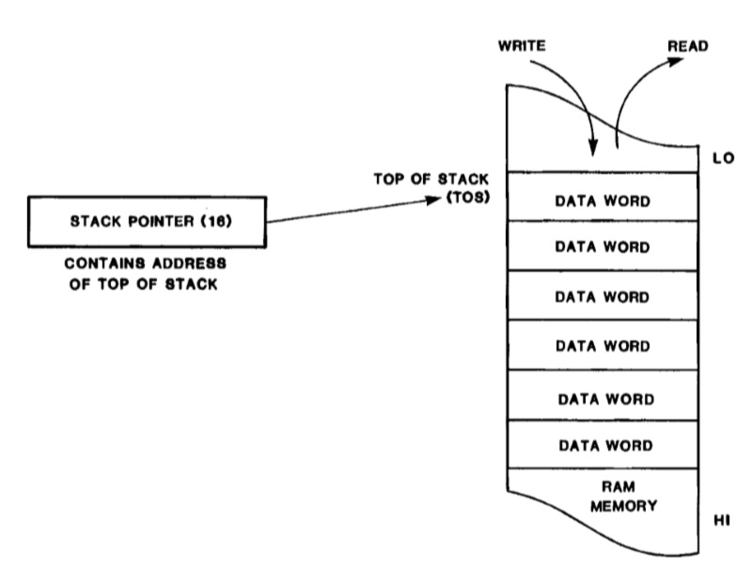
Stack Pointer

Slide 16
Instruction Pointer
Contains the offset of the next instruction. The IP and CS registers combine to form the complete address

Slide 17
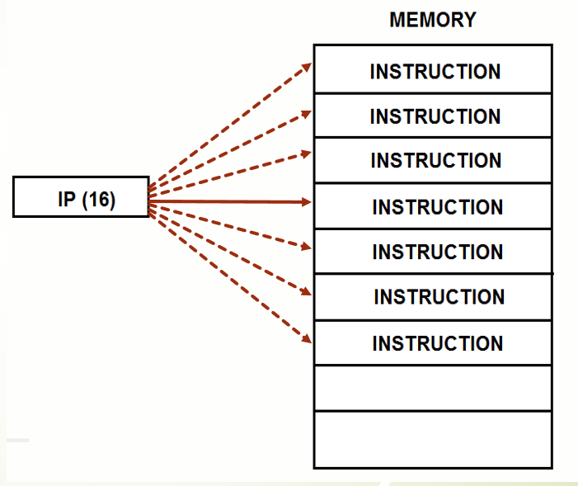
Instruction Pointer

Slide 18
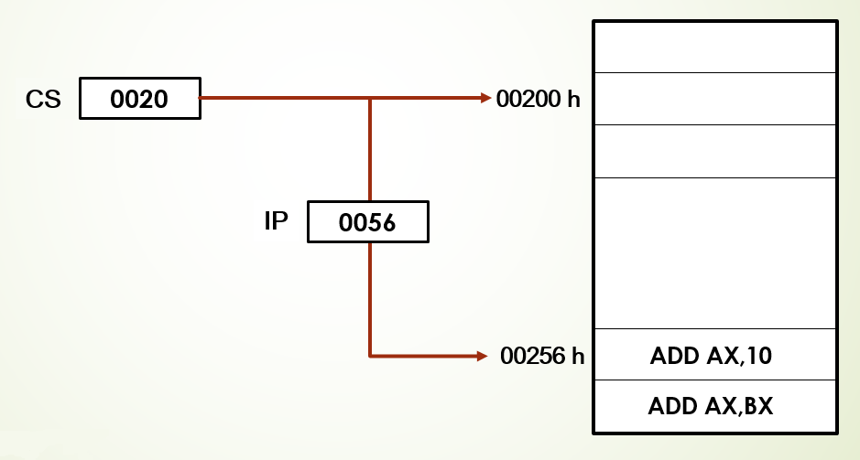
Instruction Pointer

Slide 19
Segmented Memory Model

Slide 20
Background
In earlier processors like 8080 and 8085 the linear memory model was used to access memory
8080 and 8085 could access a total memory of 64K using the 16 lines of their address bus
Now, designing for the new processor, designers wanted to remain compatible with 8080 and 8085 however 64K was too small !
There are three logical parts of our program, the code data and the stack. These three logical parts of a program should appear as three distinct units in memory.

Slide 21
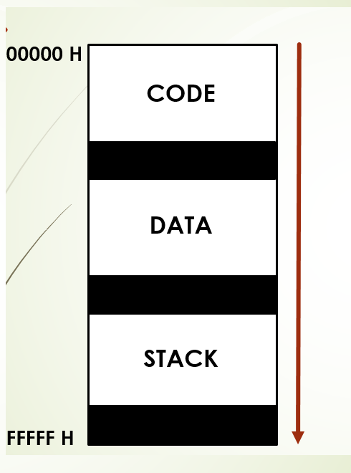

Slide 22
Memory Segment
A memory segment is a block of 2¹⁶ consecutive memory byte
Each segment is identified by a segment numbers
Within a segment memory location is specified by given offset (16-bit)
A memory location is specified by
Segment : Offset

Slide 23
Physical Address Calculation
Segment Register
Memory
Segment
+
Offset Register

Slide 24
Physical Address Calculation
16-bit segment
16-bit offset
0 0 0 0
+
0 0 0 0
20-bit segment
20-bit offset
20-bit Physical Address

Slide 25
Example
Calculate physical address for
A4FB : 4872
Formula: Physical Address = Segment x 10h + offset
A 4 F B 0 h
0 4 8 7 2 h
A 9 8 2 2 h
+

Slide 26
THE END

